Slide 1
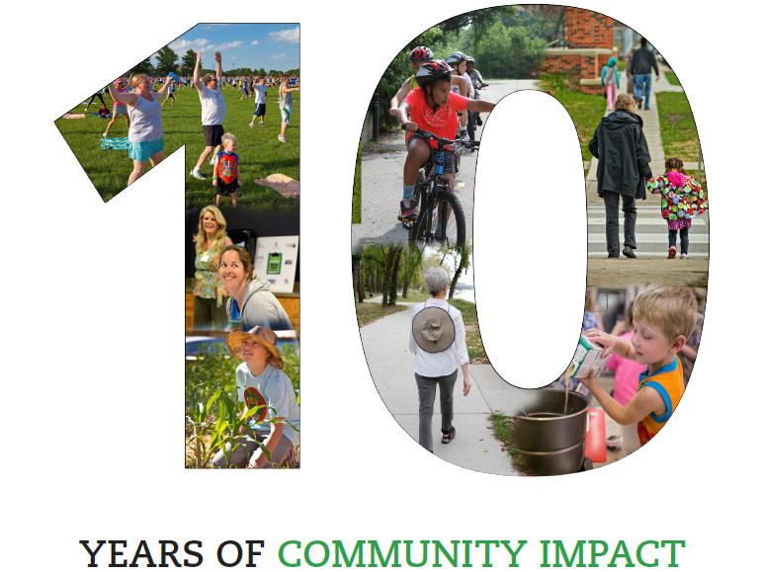
Notes:
For the past 10 years, LiveWell Douglas County has been working to shape healthier communities for all residents.

Slide 2
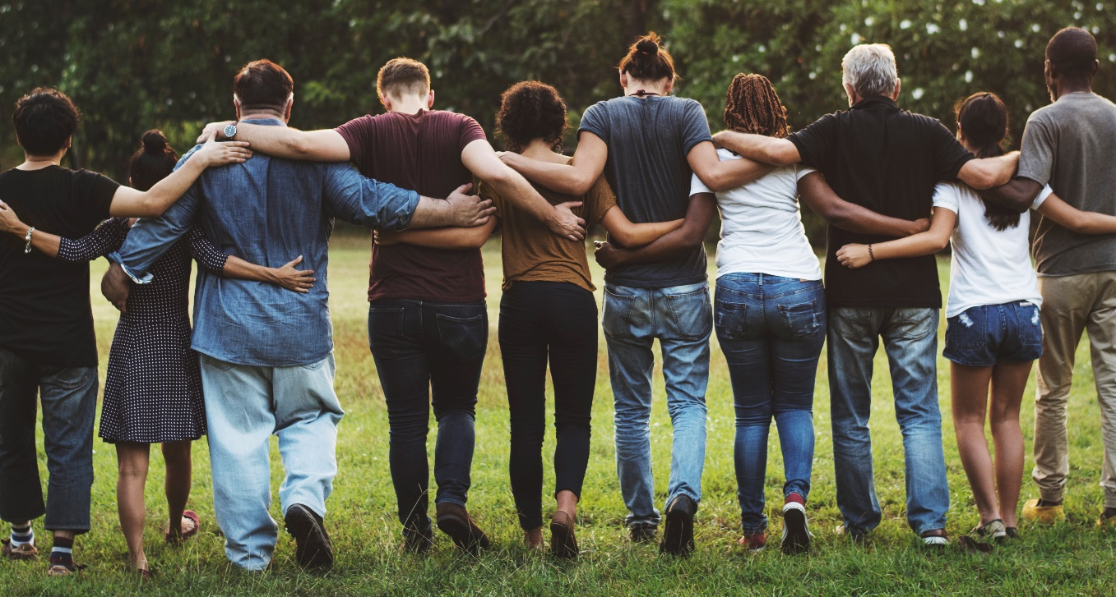
LiveWell Vision and Mission
Our Vision: Communities where we all thrive.
Our Mission: Leading a movement to build communities that support the health and well-being of all.
Notes:
LiveWell envisions Douglas County “communities where we all thrive.”
Our Mission is “Leading a movement to build communities that support the health and well-being of all.”

Slide 3
Community health improvement plan
Poverty and jobs
Behavioral health
Safe and affordable housing
Access to healthy food and physical activity
Equity & Discrimination
Notes:
LiveWell is leading efforts to address food security and a healthy built environment laid out in our 2018-2023 community health improvement plan. A lens of addressing EQUITY & DISCRIMITION is applied to all efforts. We are working to improve conditions for those experiencing the worst outcomes.

Slide 4
Partners helping shape our future
At-large community members Ballard Community Services Department of Children and Families Douglas County Food Policy Council Friends of Lawrence Area Trails Harvesters Just Food K-State Research and Extension, K-State Research and Extension SNAP KU Center for Community Health and Development KU Health, Sport, and Exercise Sciences KU Medical Center Dietetic Internship Program Lawrence-Douglas County Sustainability Lawrence-Douglas County Health Department, Lawrence-Douglas County Health Department WIC | Lawrence-Douglas County Housing Authority Full Circle Youth Program LMH Health Lawrence Pedestrian Coalition Lecompton United Methodist Church Food Pantry Salvation Army Senior Resource Center for Douglas County STA Care Center Success by 6 Coalition of Douglas County Sustainability Action Network University of Kansas Center for Community Health and Development University of Kansas Research and Training Center on Independent Living USD 497 Lawrence Public Schools
Notes:
We are so grateful for the many individuals and groups who are engaged in LiveWell’s critical work.

Slide 5
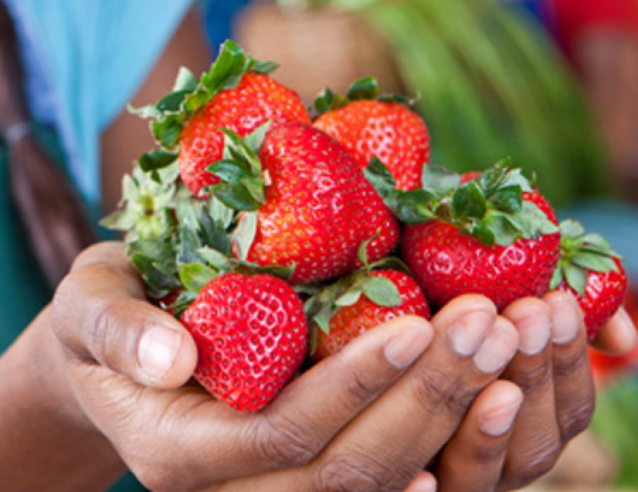
Reducing Food Insecurity
Notes:
The community-determined strategies for making these improvements to reduce food insecurity in our Douglas County communities include:
Ensuring enhanced food access for populations facing transportation barriers, such as through establishing a mobile food pantry
Growing food recovery practices and policies to supply safe, nourishing food to those in need
Strengthening the FuelGood Healthy Pantries Initiative to promote adoption of health-promoting policies and practices
Removing barriers to and strengthening utilization of public food assistance programs for families with children and seniors, including School breakfast, dinner, and summer meal programs; SNAP; WIC; Double Up Food Bucks; CHAMPPS; Meals on Wheels; and Commodity Supplemental Food Program for seniors
Supporting advocacy efforts
Extending food pantry evening/ weekend availability
And growing “Hunger and Health” efforts to enhance integration of social services and health care (such as diabetes screening and self-management support at local pantries)

Slide 6
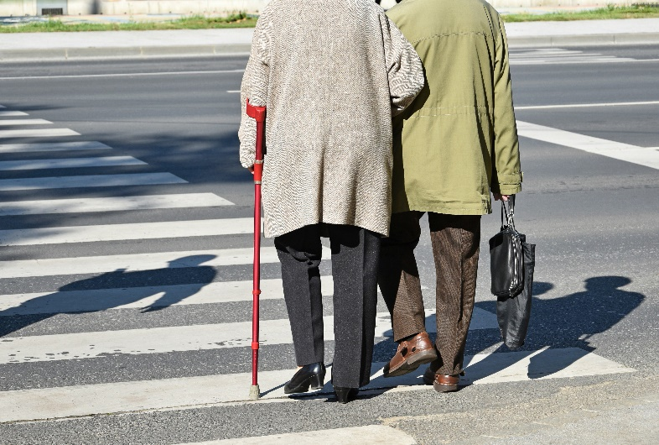
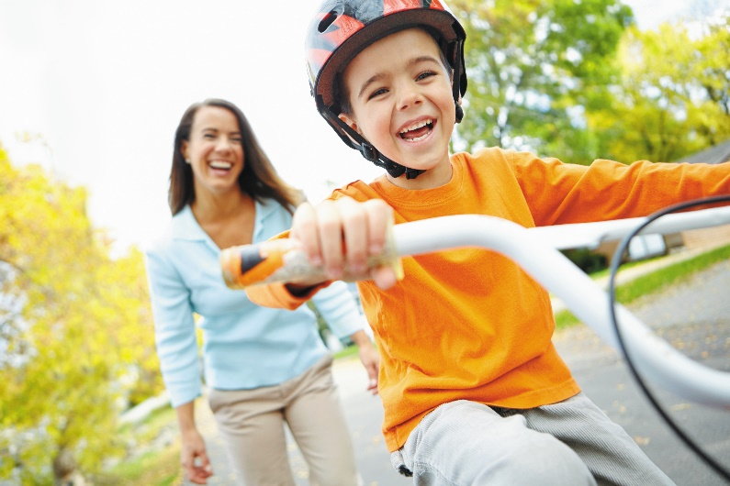
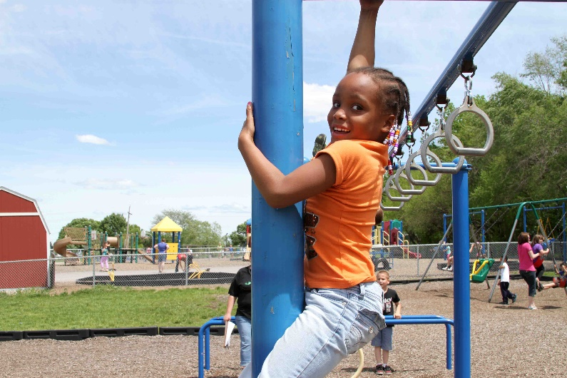
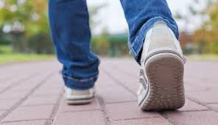
Healthy Built Environment
Notes:
Strategies for making improvements to our built environment include:
Working with local cities to advance a safe and robust pedestrian and bicycle network
Working with school districts and municipalities to assure completion, adoption, and implementation of regional or school district Safe Routes to School Plans
Supporting school districts’ efforts to adopt evidence-based policies that support opportunities for youth to be physically active
Supporting ongoing development of public transit, with access for people of all abilities
Promoting community initiatives that support well maintained, equitably funded sidewalk networks.
And increasing the number of workplaces that are actively engaged with Healthy Eating Active Living (HEAL) initiatives

Slide 7
LiveWell expansion
Notes:
LiveWell has additionally worked with the Health Department, the Sexual Trauma and Abuse Care Center, and local community residents to form work groups to address tobacco use and sexual violence prevention. LiveWell will continue to utilize multi-sectoral partnerships to respond to emergent community opportunities and needs.

Slide 8
What’s Ahead
The support of key community partners is critical for ensuring sustainability into the future.
Notes:
Our community is telling us what is important, and we are listening.
Only working together can we continue this important work.
Thank you for your support as we work towards a day when Douglas County is a place where all people thrive.

